Slide 1
陳擎文
GA Operating Instructions(1)

Slide 2
Unit Outline
1. How GA works 2. The overall structure of the GA account 3. Three jobs to operate a GA account 4. Apply for an account on the GA platform and create resources 5. How does our website hw4 connect to GA4? 6. Check if the GA4 code is installed successfully? 7. Connect our website hw3 to GA4

Slide 3
1. How GA works

Slide 4
1. How GA works
◉ Google Analytics code analysis primarily uses tracking technology through page tags to collect data.
◉ We can apply it to specific pages or every page, so that when users visit a webpage, their browsing information is captured by Google Analytics' tracking code.
This tracking code monitors the actions taken by visitors on each page and sends the data to GA's database, which is then presented in various reports within GA.

Slide 5
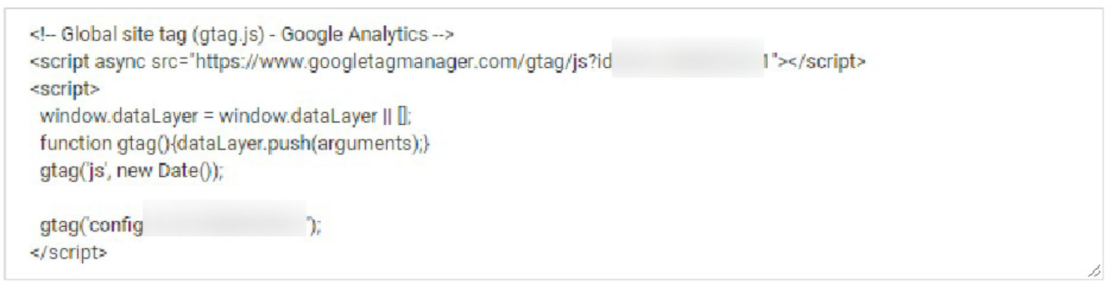
1. How GA works
◉ By placing the Google Analytics tracking code in the <HEAD> of the webpage, it acts like a "monitor," tracking visitors' behavior on the site.

Slide 6
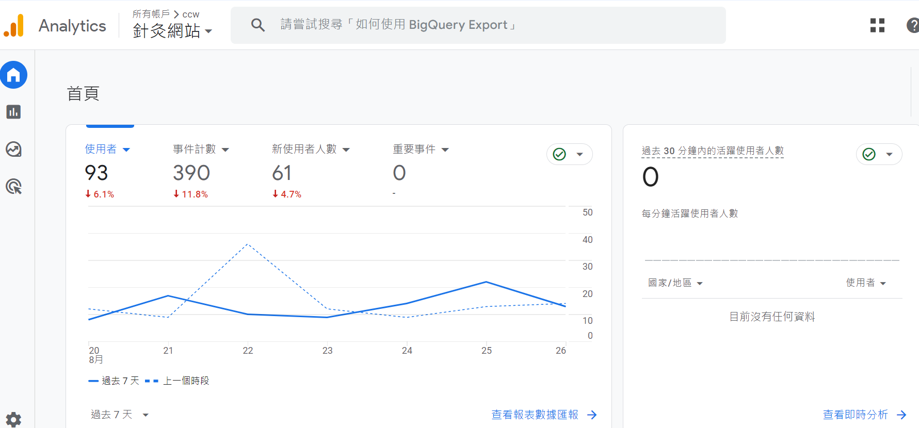
1. How GA works

Slide 7
☎ Important Concepts:
2. The overall structure of the GA account

Slide 8
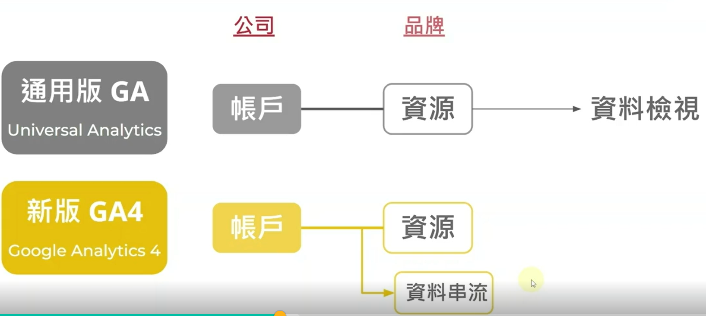
2. GA's Account Structure GA has a new version, an old version
old edition GA: 通用版GA, Universal Analytics new edition GA: GA4 , Google Analytics 4

Slide 9
2. GA 的帳號架構 For now, just look at the new version of GA4
[Account]: For a company, it is to apply for 1 GA account [Resources]: A company has many brands, and 3 brands will establish 3 resources (3 different websites) [Data Streaming]: 1 brand can set up to 3 data streams: website, IOS APP, Android APP

Slide 10
☎ Important Concepts:
3. Operate the GA account Three jobs

Slide 11
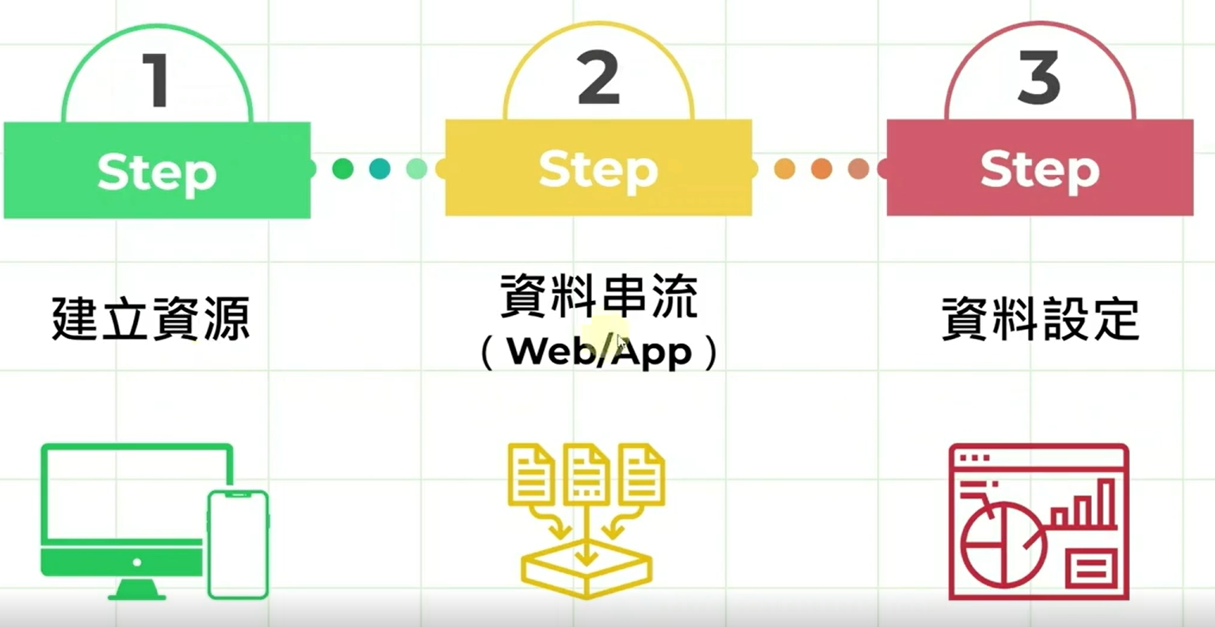
Three jobs to operate a GA account

Slide 12
Three jobs to operate a GA account
Task 1: Create a brand website, essentially establishing a resource.
Task 2: Set up the web traffic sources related to the brand website (website URL, App).
Task 3: Configure related settings (e.g., retain web data for 3 months…).

Slide 13
4. Go to the GA platform Apply for an account and build resources

Slide 14
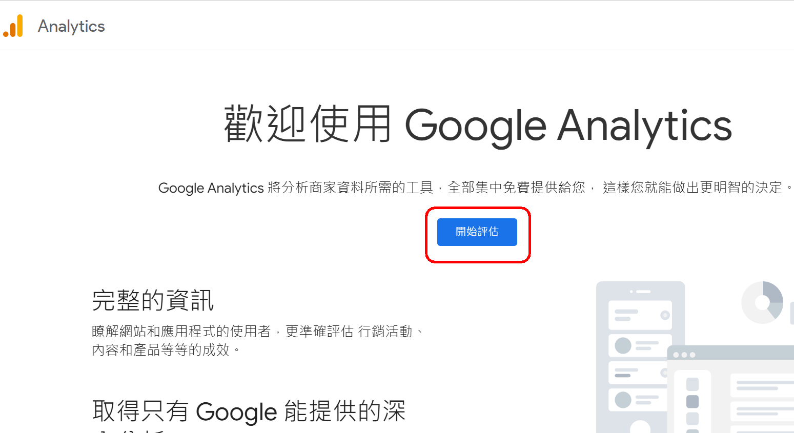
(1) To apply for a GA account, Method 1: 新手第1次，從【開始評估】

Slide 15
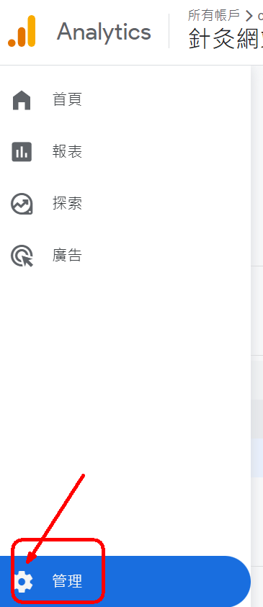
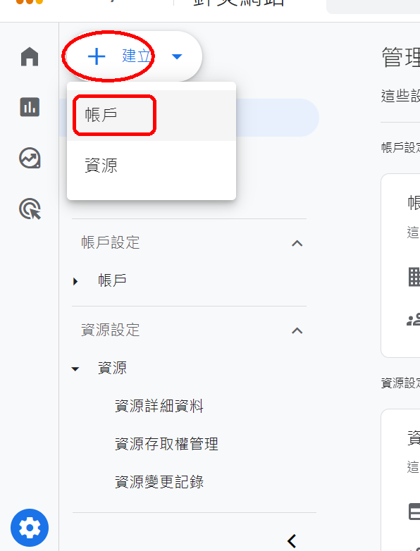
(1) To apply for a GA account, Method 2: Old students will be added in the future➜齒輪【管理】
1. Bottom left【管理】➜【建立】➜帳戶

Slide 16
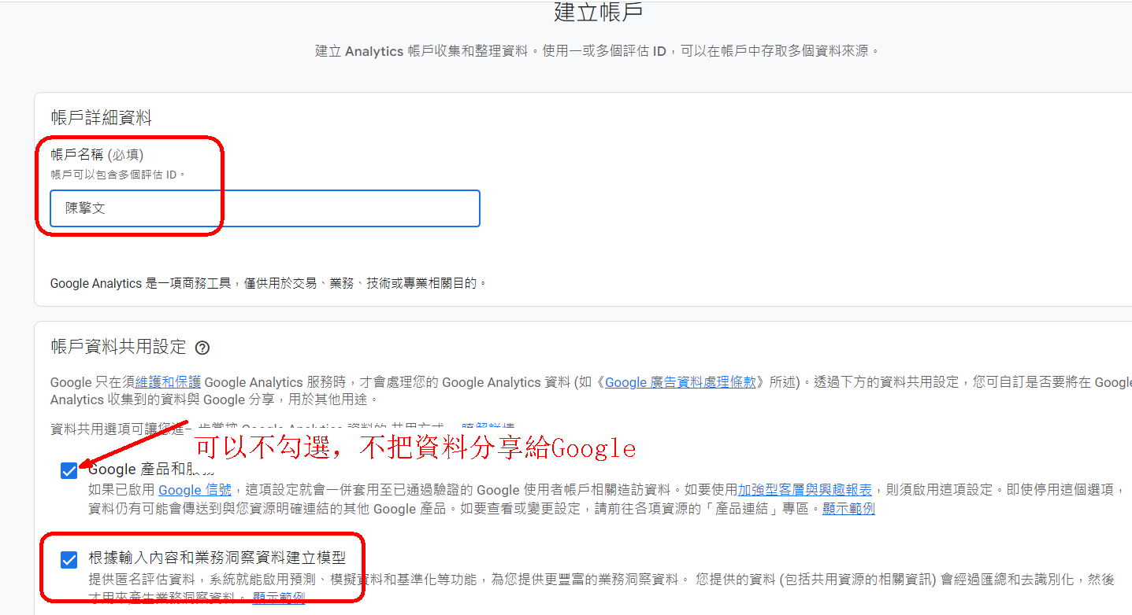
① Applying for GA (Google Analytics) in 5 steps:Create an account.
Account: Individual's name（or company name)

Slide 17
① Applying for GA in 5 steps: Step 2: Create a property.
Property: Brand Name (or Website Name)
Examples:
Company: Uni-President統一
Brands:
- 7-Eleven
- Uni Orange Drink
- Dream Mall
Company: HTC
Brands:
- HTC
- VIVE (Virtual Reality Equipment)

Slide 18
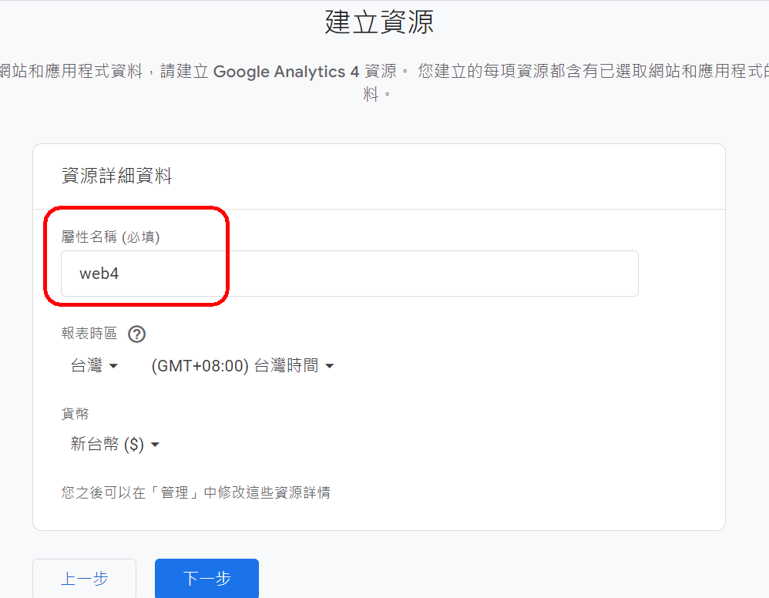
資源名稱：It should be the brand name of the company 課程實作：web4

Slide 19
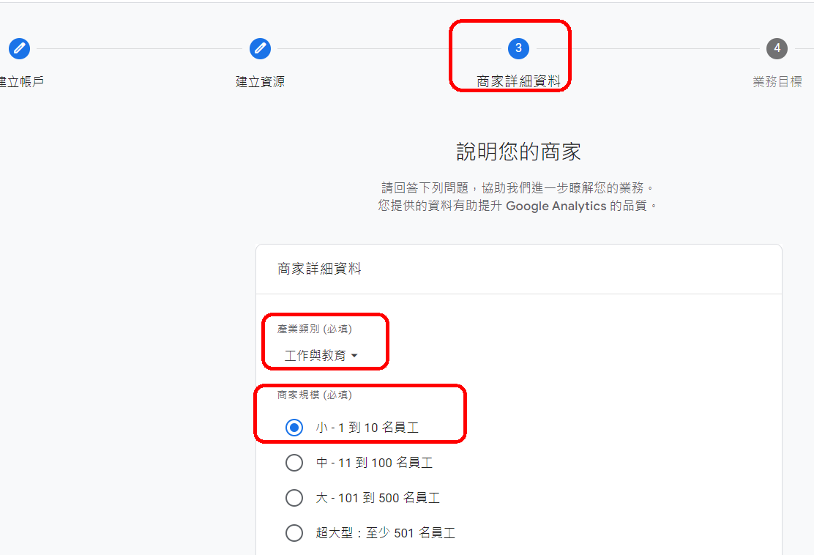
Step 3: Business Details

Slide 20
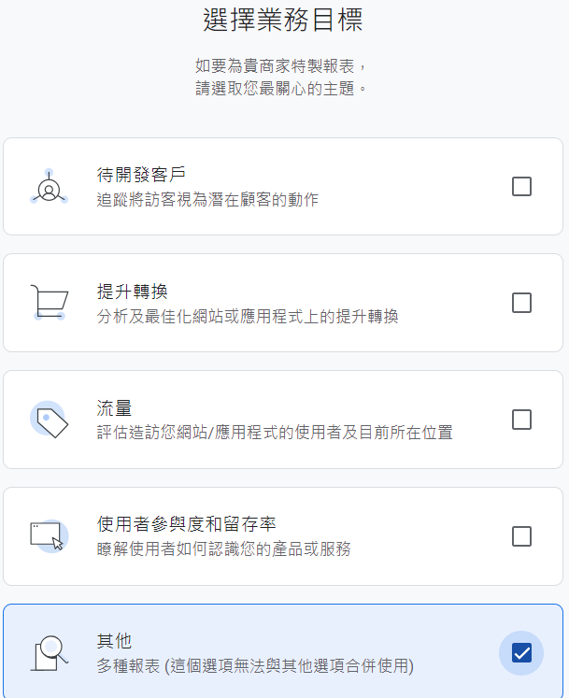
Step 4: Business Goals
Set your goals with GA4 If you want to select a report Everything else is included

Slide 21
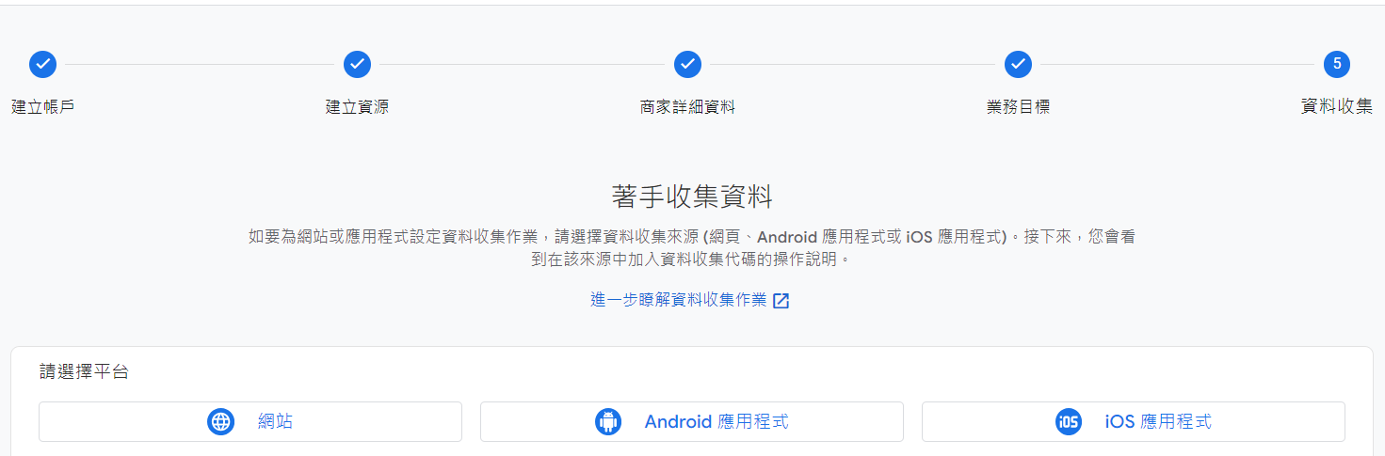
Complete 5 steps
GA4 allows up to 【3 connections】 to brand properties for integration.
網站，Android App， IOS APP

Slide 22
5. Our website hw4 How to connect to GA4

Slide 23
5. How our website is linked to GA4
Step 1: Example website 4 has been completed and uploaded to Github.
The URL of the website is already known：https://ccwntut.github.io/hw4/

Slide 24
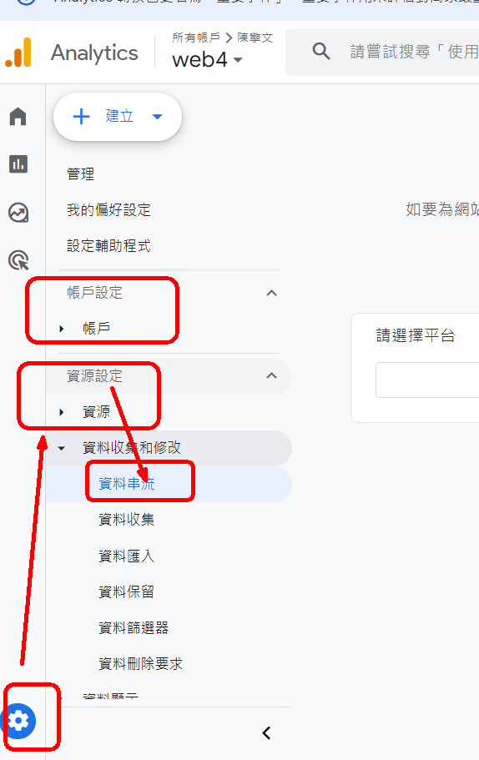
5. How our website is linked to GA4
Step 2. Go to the GA4 platform website，
【齒輪管理】
➜【帳戶】
➜【資源：web4】
➜資料串流

Slide 25
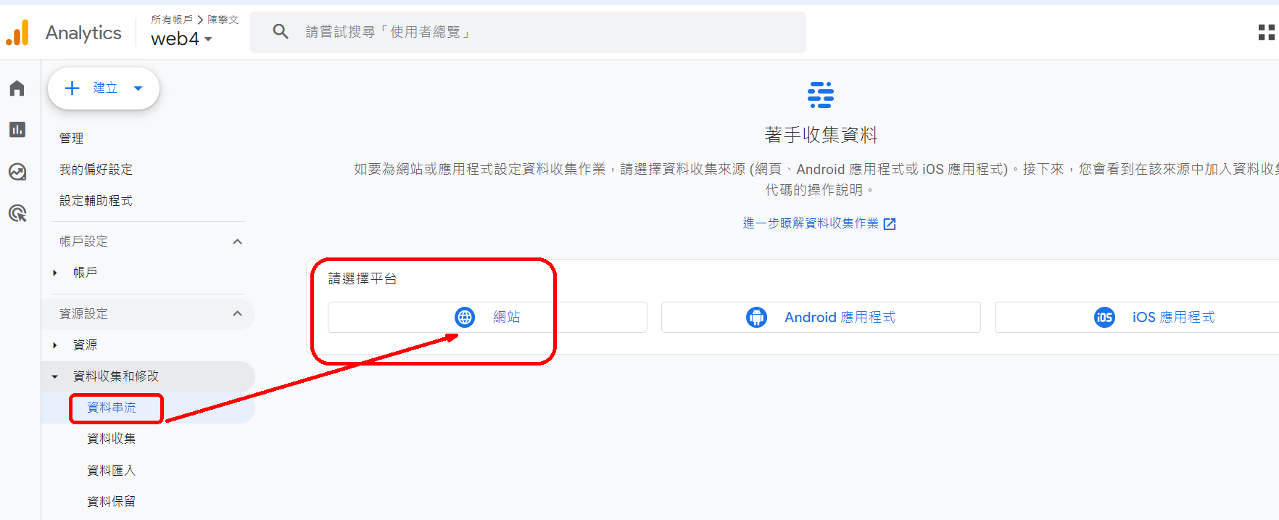
資料串流➜選擇【網站】

Slide 26
Enter the URL: Which domain should I use?
Note: Which of the following is put here？
Directory domains：ccwntut.github.io
or a subdirectory domain： ccwntut.github.io/hw4
Which one is correct?？
Note: Do not put the last 1 letter【/】
Wrong way to write it： ccwntut.github.io/hw4/
串流名稱：web4

Slide 27
Enter the URL: Which domain should I use?
URL set to:ccwntut.github.io/hw4
GA4 can only track the traffic under the **hw4** directory
and cannot track other parts of your website.
URL set to:ccwntut.github.io
GA4 can track all traffic to your entire website

Slide 28
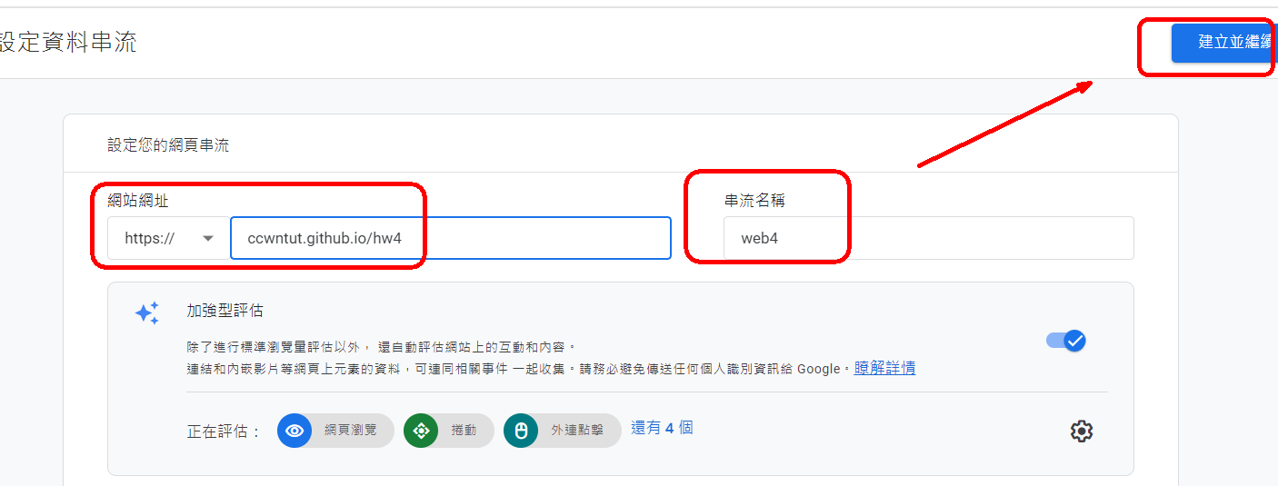
Establish a data stream 建立資料串流 ccwntut.github.io/hw4

Slide 29
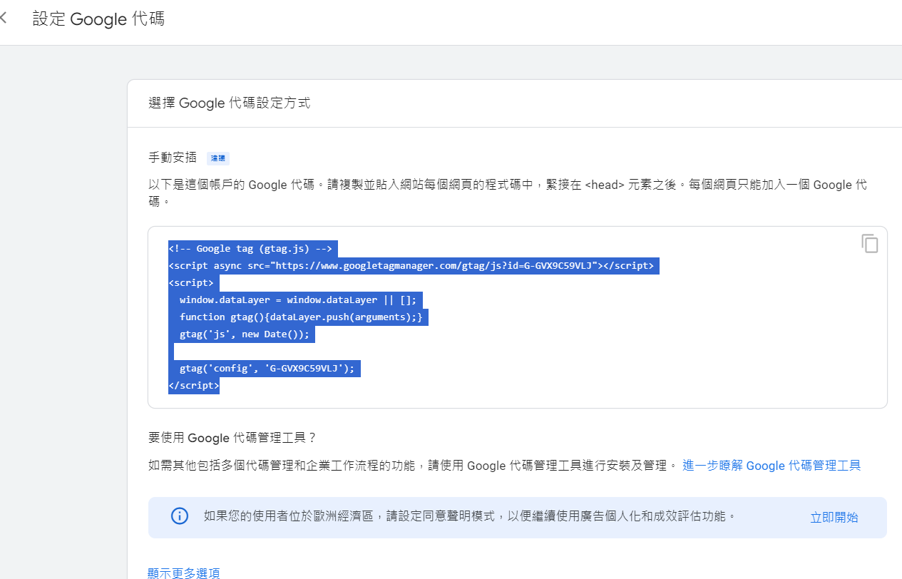
Step 3: Copy the Google code into each page<head>

Slide 30
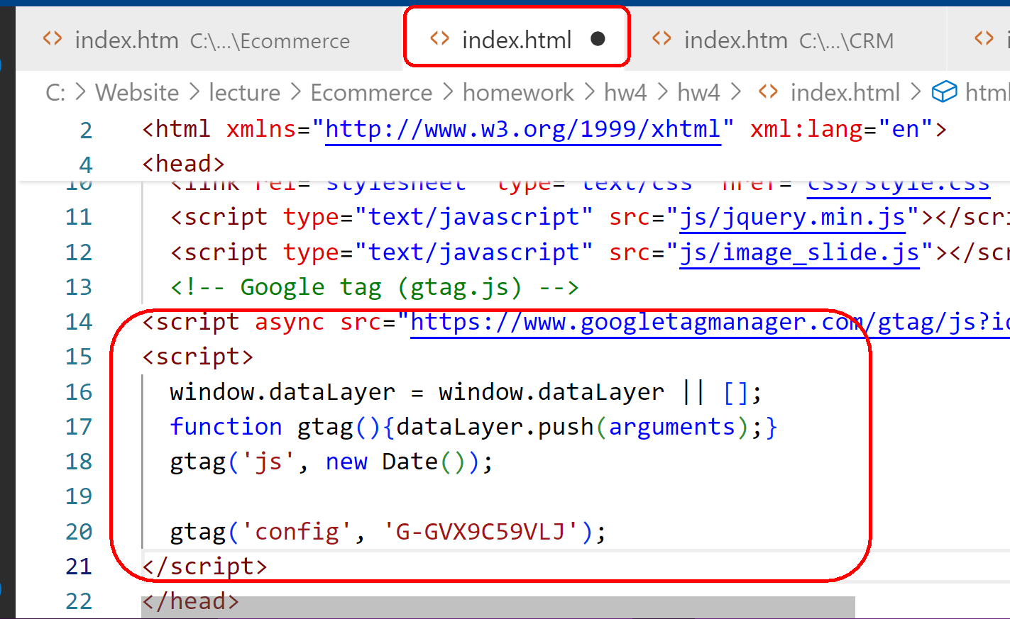
Open the **hw4** pages: index/a1/a2/a3/a4, and paste the GA4 code.

Slide 31
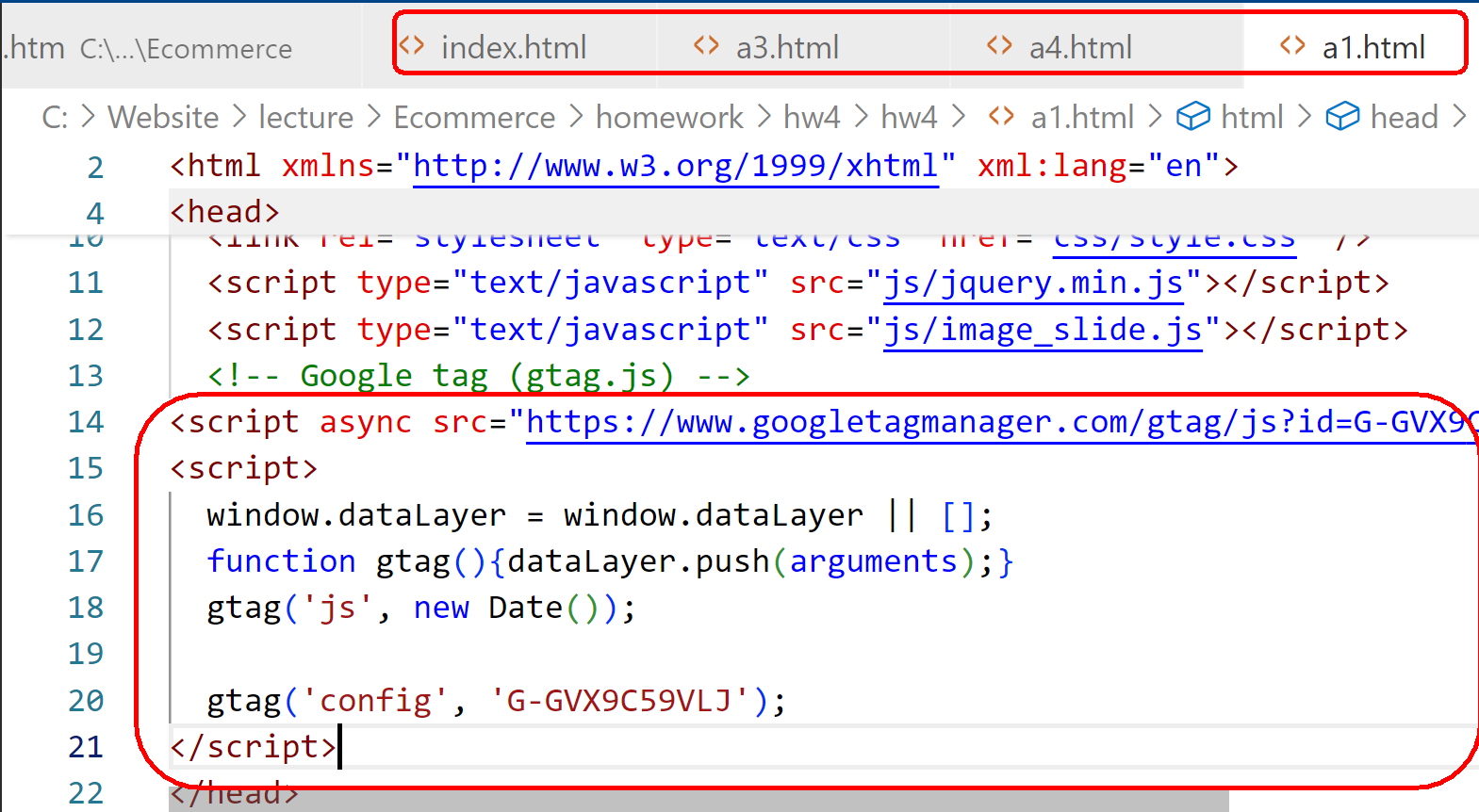
Open the **hw4** pages: index/a1/a2/a3/a4, and paste the GA4 code.

Slide 32
Open the **hw4** pages: index/a1/a2/a3/a4, and paste the GA4 code.
note：
1 web page, only 1 GA4 code can be placed, If you place 2 of them, an error will occur

Slide 33
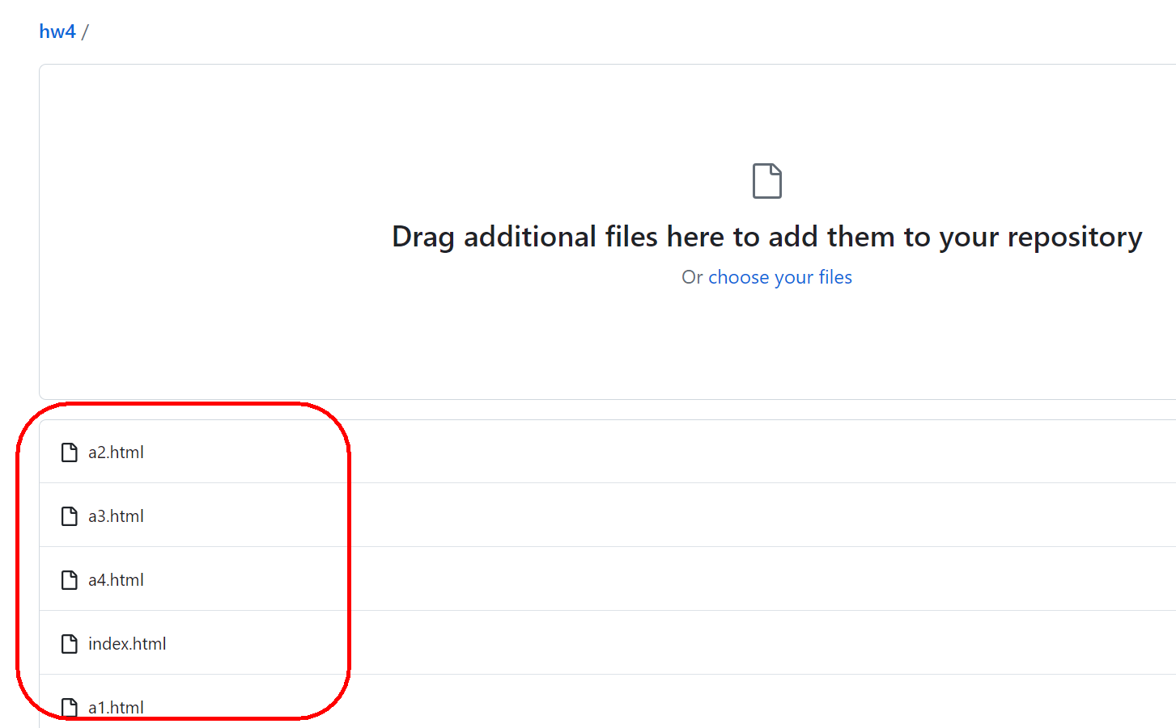
重新上傳hw4的index/a1/a2/a3/a4網頁到Github

Slide 34
6. Check if the GA4 code is installed successfully?

Slide 35
6. Check if the GA4 code is installed successfully?
Method 1: Use GA4 Real-Time Report View
Method 2: Use the Google Tag Assistant website to do a test check

Slide 36
Method 1: Use GA4 Real-Time Report View
方法2：使用Google Tag Assistant網站來做測試檢查

Slide 37
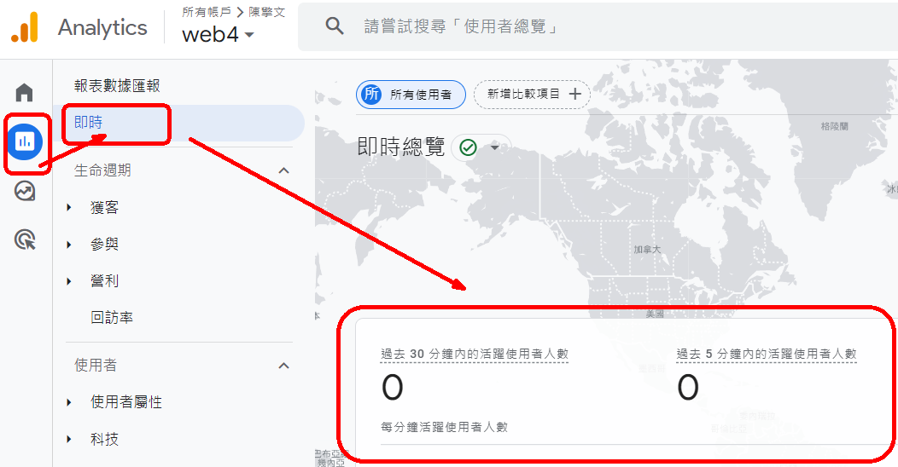
Method 1: Use GA4 Real-Time Report View
Step 1: Go to the GA4 platform first：
【左上角Menu選單】 ➜【報表】 ➜【即時報表】➜目前30分鐘內0人

Slide 38
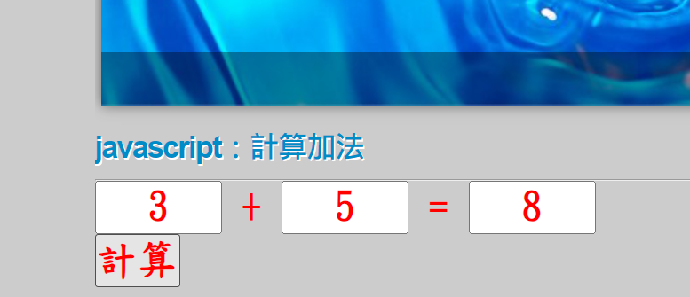
Method 1: Use GA4 Real-Time Report View
Step 2: Go to the website in Example 4：
ccwntut.github.io/hw4
Do the "Web Browsing" action
Button click action
In the early days of GA, after a web browsing/click, it took 5 minutes for GA4 to display the data

Slide 39
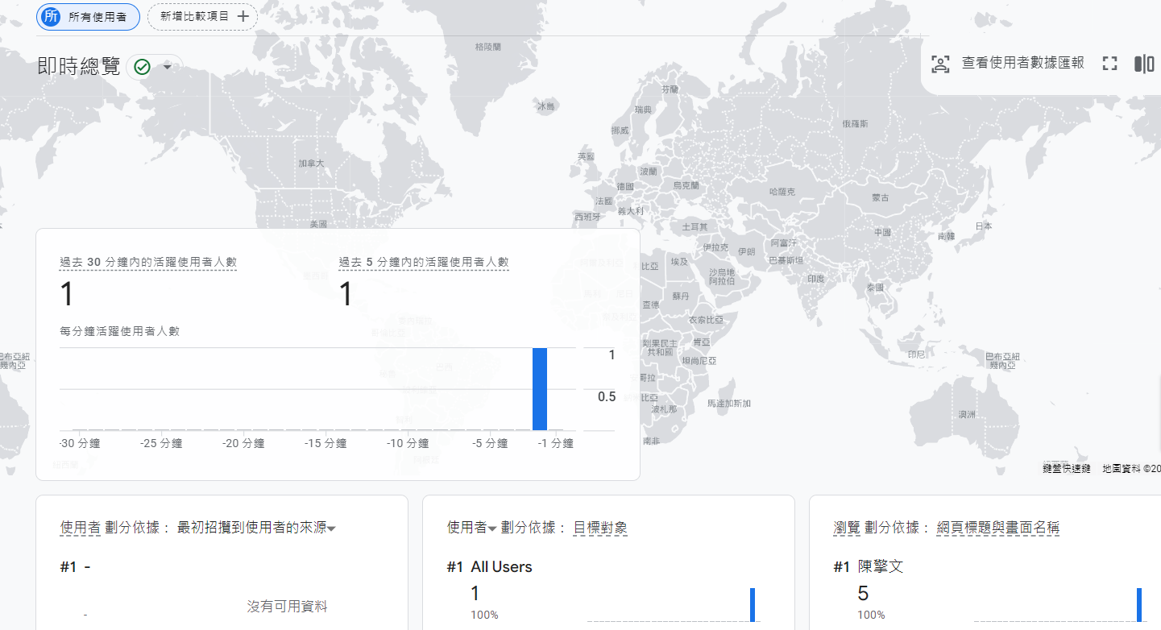
Step 3: Back to the GA4 platform:【左上角Menu選單】 ➜【報表】 ➜【即時報表】

Slide 40
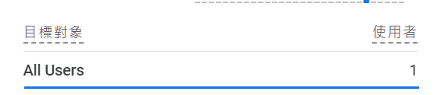
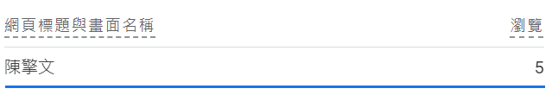
Step 3: Back to the GA4 platform:【左上角Menu選單】 ➜【報表】 ➜【即時報表】
The number of active users in the last 30 minutes: 1 Number of active users in the last 5 minutes: 1
Users are segmented by: Source #1 of the initial user attraction

Slide 41
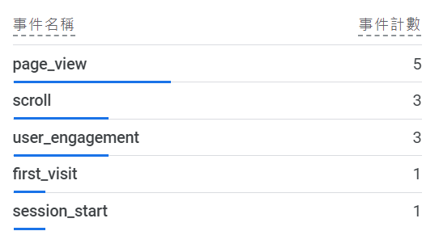
Step 3: Go back to the GA4 platform： 【左上角Menu選單】 ➜【報表】 ➜【即時報表】

Slide 42
方法1：使用GA4 即時報表檢視
Method 2: Use the Google Tag Assistant website to do a test check

Slide 43
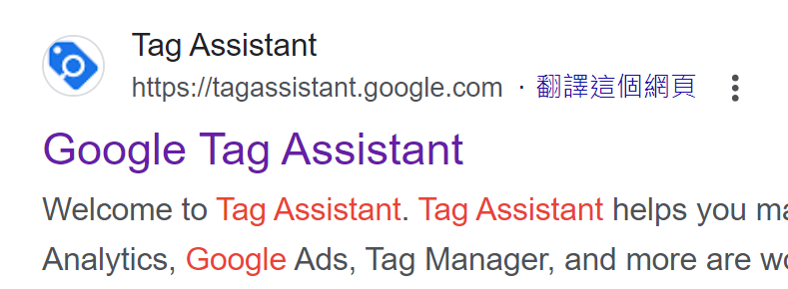
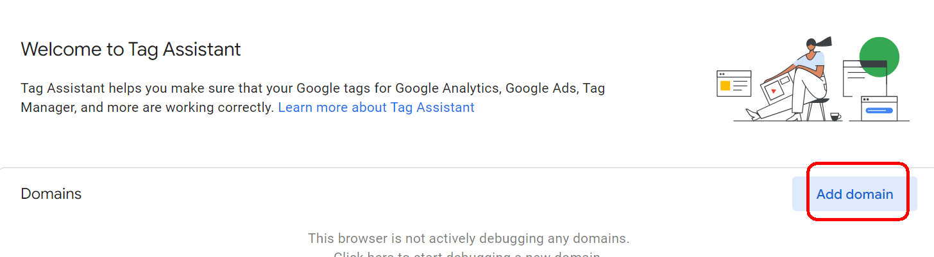
Method 2: Use the Google Tag Assistant website to do a test check
1. Go to the Google search engine and type:
Google Tag Assistant
https://tagassistant.google.com/
Add Domain

Slide 44
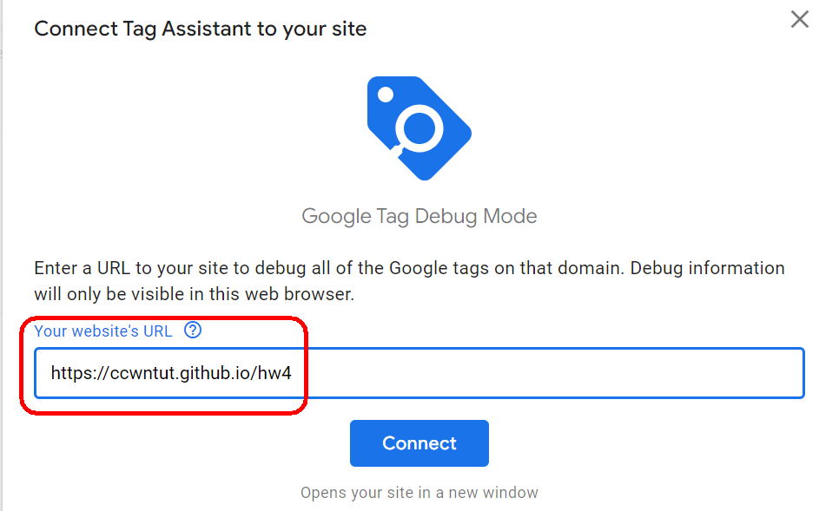
Method 2: Use the Google Tag Assistant website to do a test check
Add Domain
https://ccwntut.github.io/hw4

Slide 45
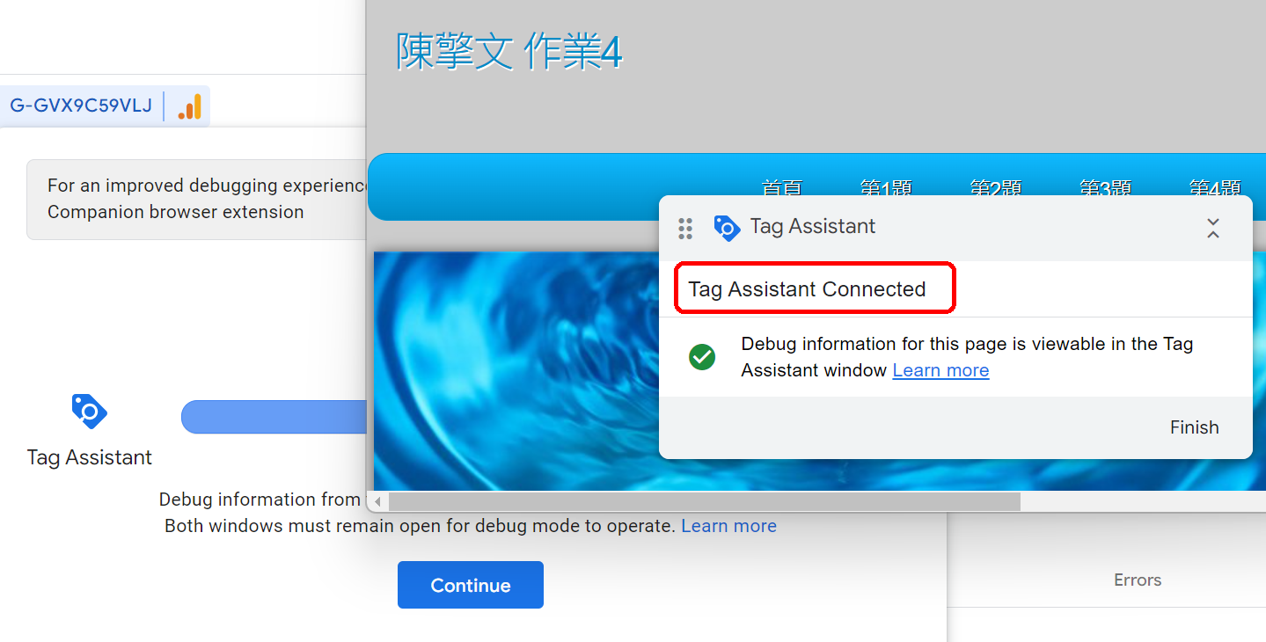
Domain → Google Tag Assistant 已經連線

Slide 46
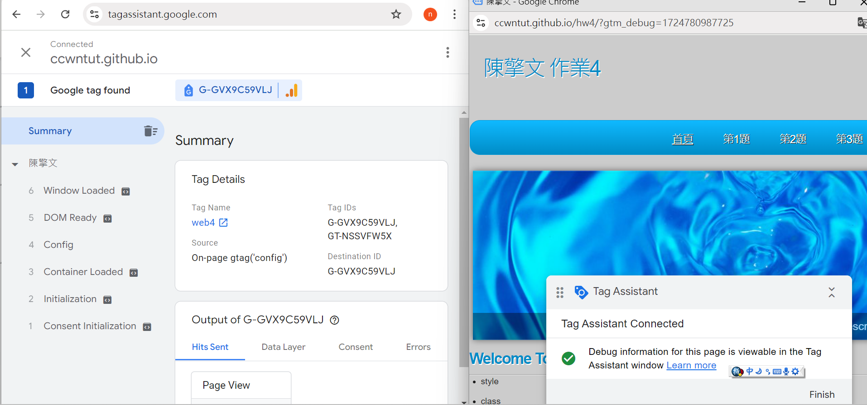
Side-by-side 2 web page comparison: scroll/click on the hw4 web page ➜ See the instant reaction of Google Tag Assistant

Slide 47
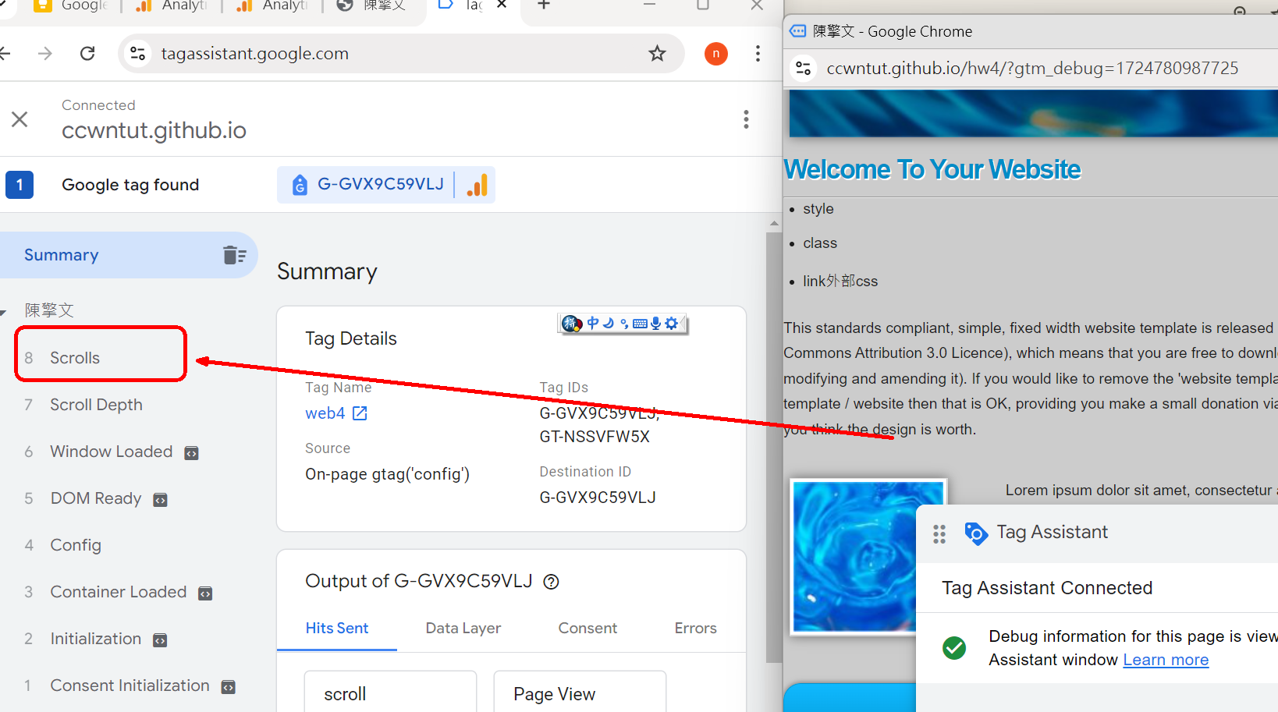
Scroll through the web page a1.html ➜Google Tag Assistant有Scrol事件

Slide 48
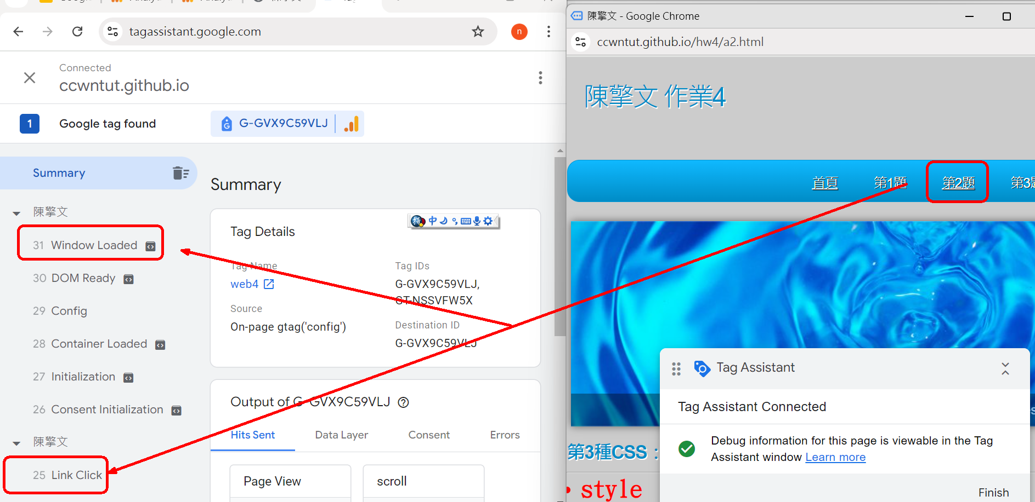
點按超連結到a2.html➜Google Tag Assistant有link click，windows load事件

Slide 49
7. Place our website on hw3 Concatenation to GA4

Slide 50
8. to the GA 4 platform Select your account to build resources in web3

Slide 51
齒輪【管理】
1.左下角【管理】➜【建立】➜資源

Slide 52
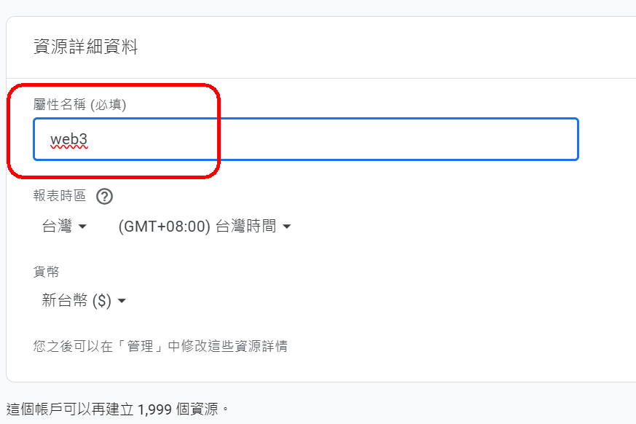
Build new resources：web3

Slide 53
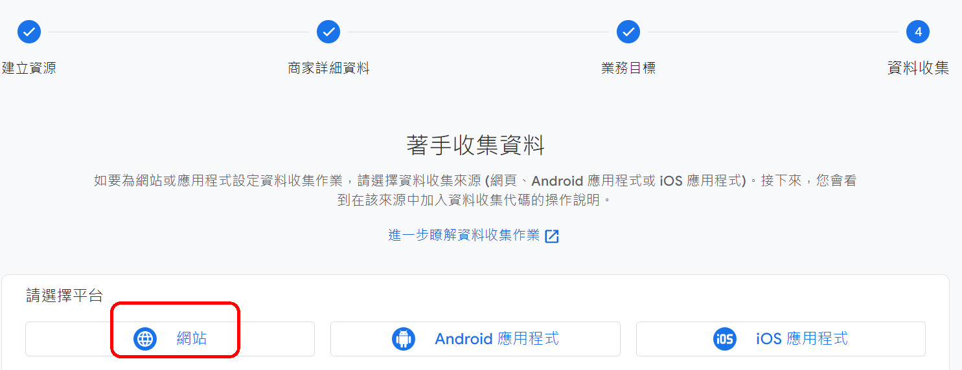
Direct configuration【資料串流】→ 網站

Slide 54
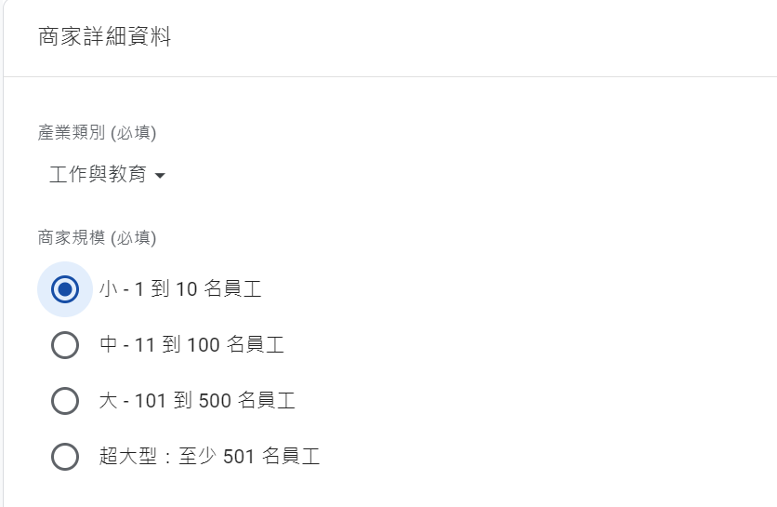

Slide 55
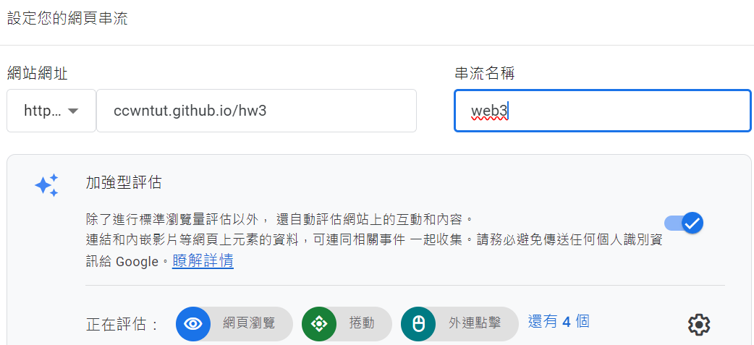
establish資料串流 ccwntut.github.io/hw3
串流名稱：web3

Slide 56
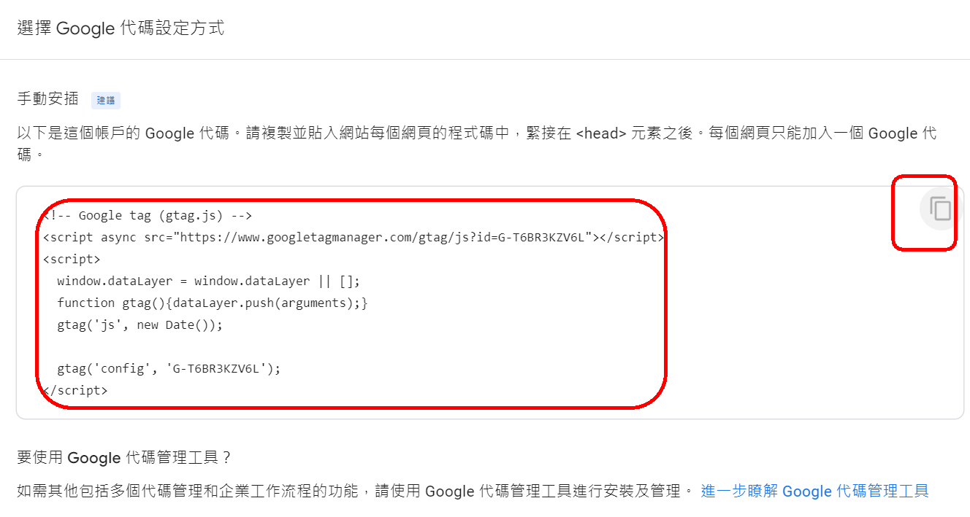
Copy the code to hw3的index/a1/a2/a3/a4

Slide 57
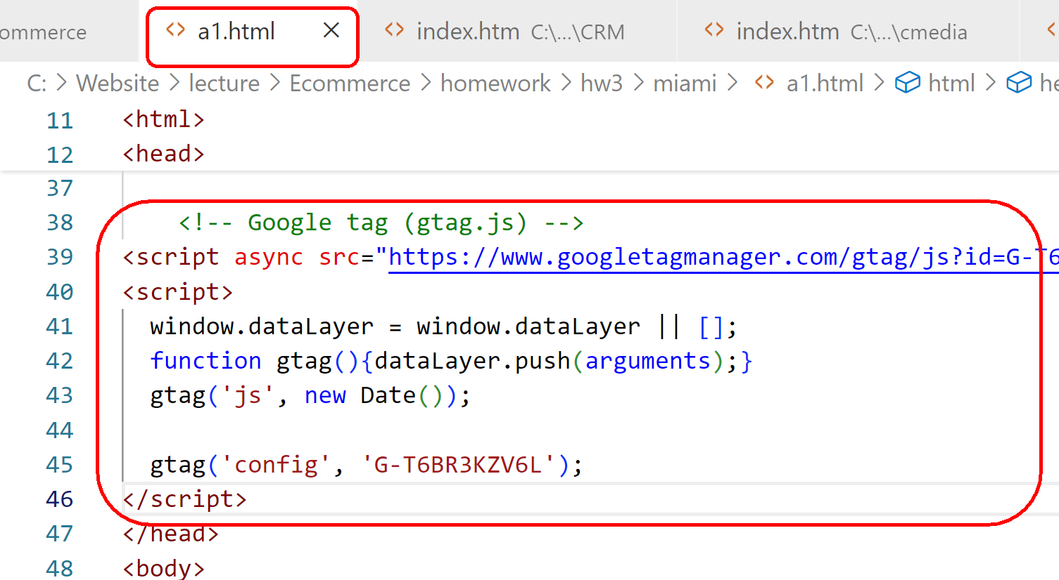
Copy the code to hw3的index/a1/a2/a3/a4

Slide 58
Re-uploaded hw3的index/a1/a2/a3/a4網頁到Github

Slide 59
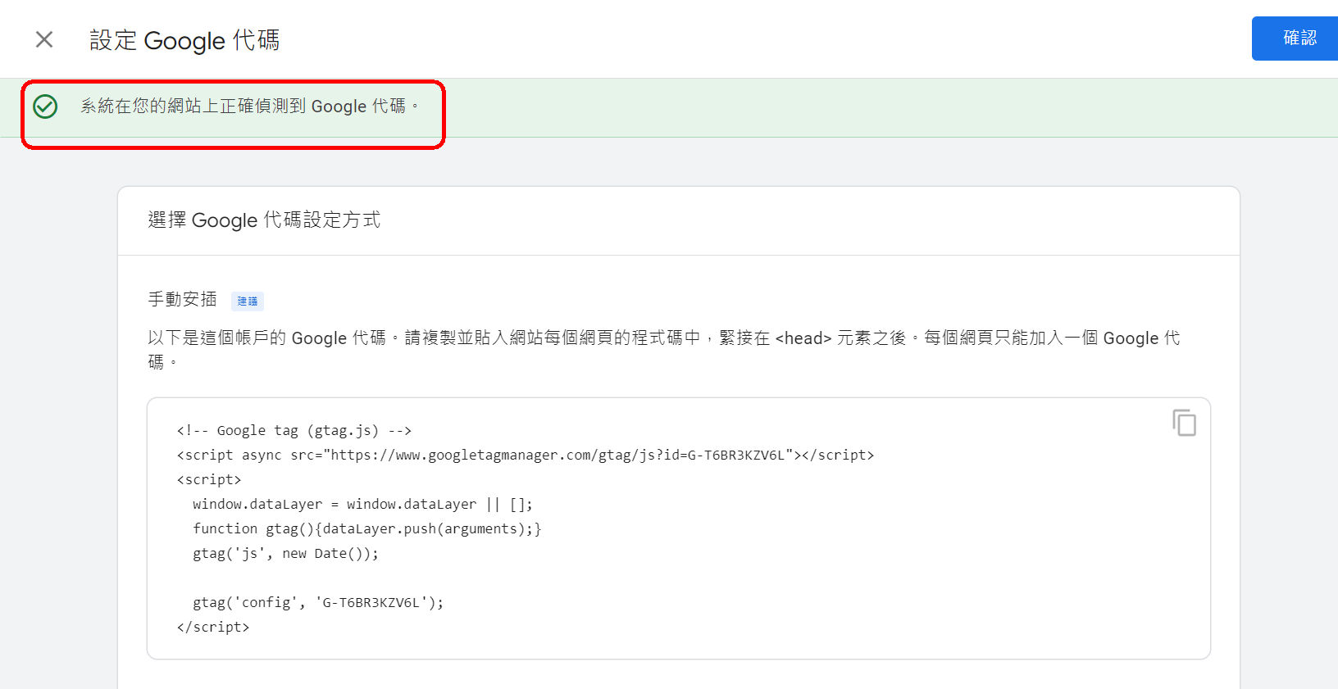
Back to the GA4 platform: Is the test already installed successfully?
The Google tag is correctly detected on your site

Slide 60
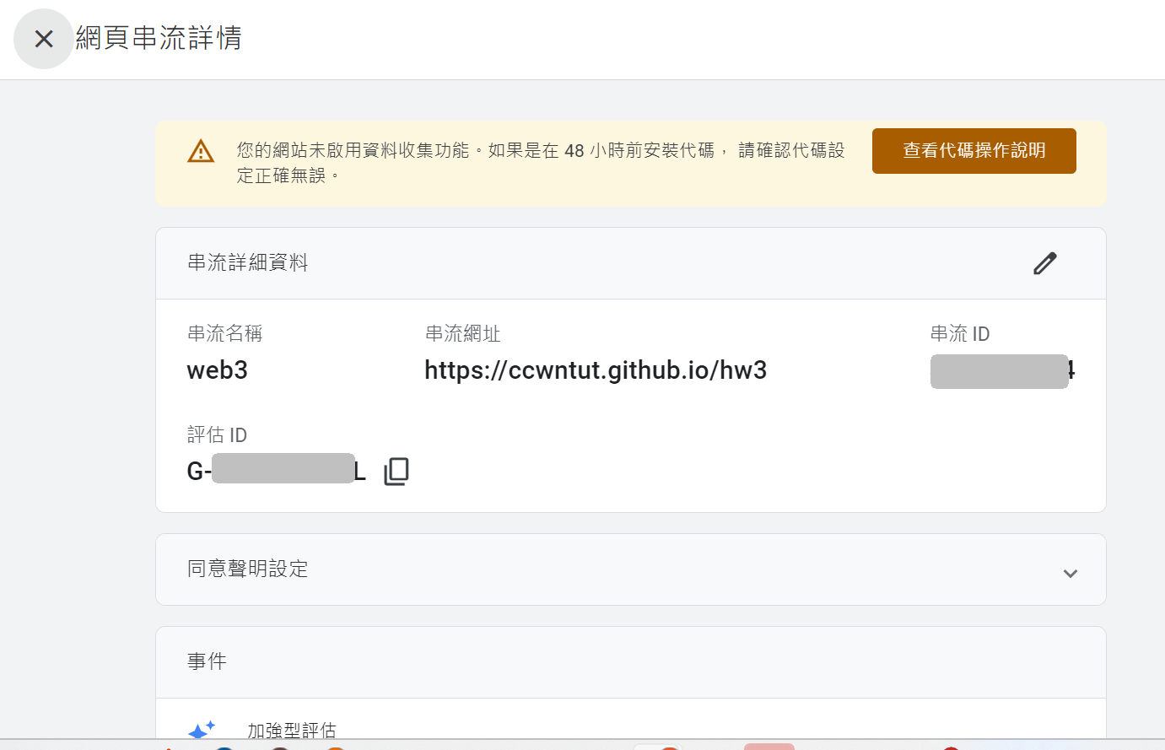

Slide 61
6. Check if the GA4 code is installed successfully?
Method 1: Use GA4 Real-Time Report View
Method 2: Use the Google Tag Assistant website to do a test check

Slide 62
Method 1: Use GA4 Real-Time Report View
方法2：使用Google Tag Assistant網站來做測試檢查

Slide 63
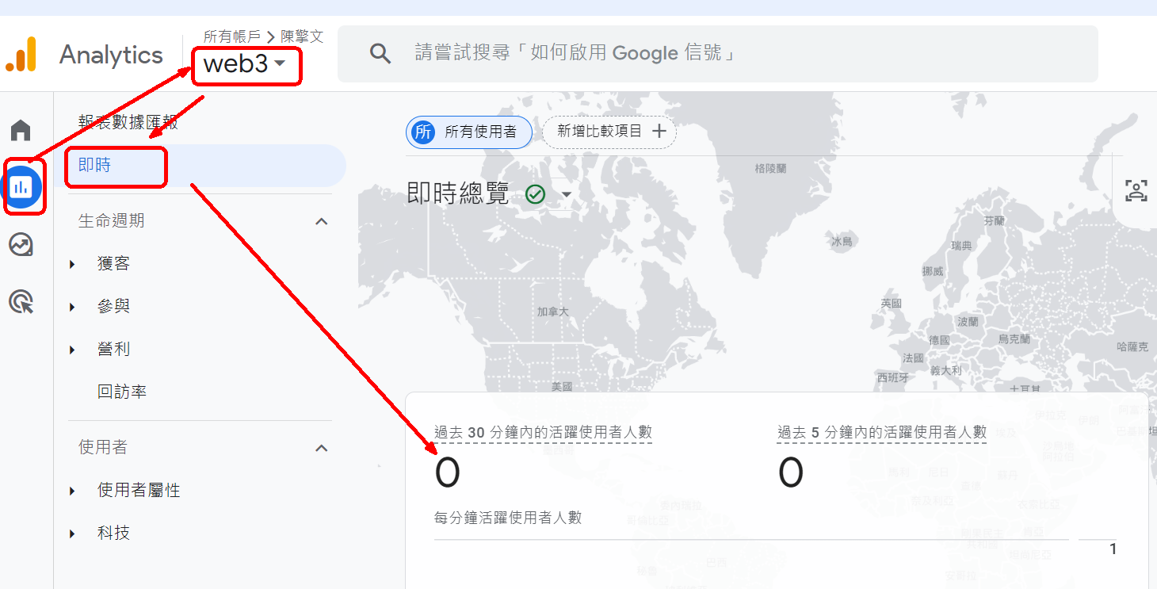
Method 1: Use GA4 Real-Time Report View
Step 1: Go to the GA4 platform first：
【左上角Menu選單】 ➜【報表】 ➜【即時報表】➜目前30分鐘內0人

Slide 64
Method 1: Use GA4 Real-Time Report View
Step 2: Go to the website in Example 4：
ccwntut.github.io/hw3
做【網頁瀏覽】動作
【按鈕點擊】動作
早期的GA，網頁瀏覽/點擊後，要等5分鐘，GA4才會顯示數據

Slide 65
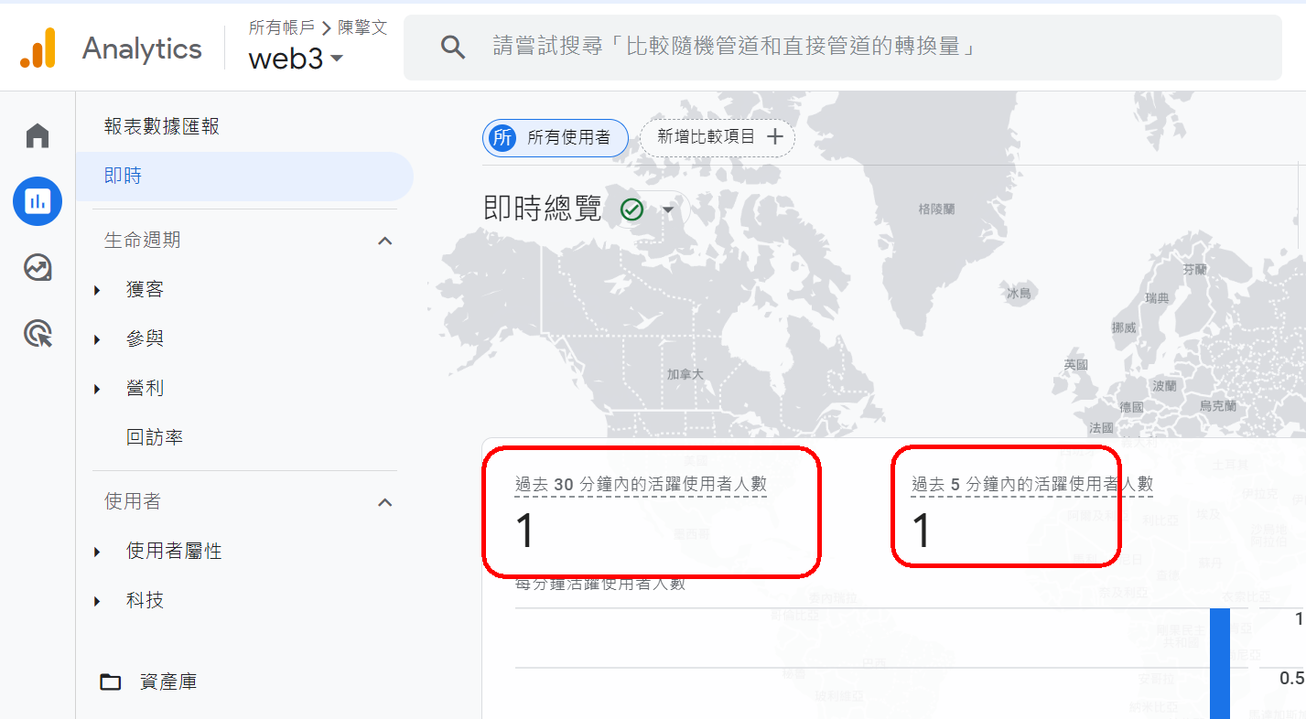
Step 3: Back to the GA4 platform: 【左上角Menu選單】 ➜【報表】 ➜【即時報表】

Slide 66
方法1：使用GA4 即時報表檢視
Method 2: Use the Google Tag Assistant website to do a test check

Slide 67
Method 2: Use the Google Tag Assistant website to do a test check
1. Go to the Google search engine and type:
Google Tag Assistant
Add Domain

Slide 68
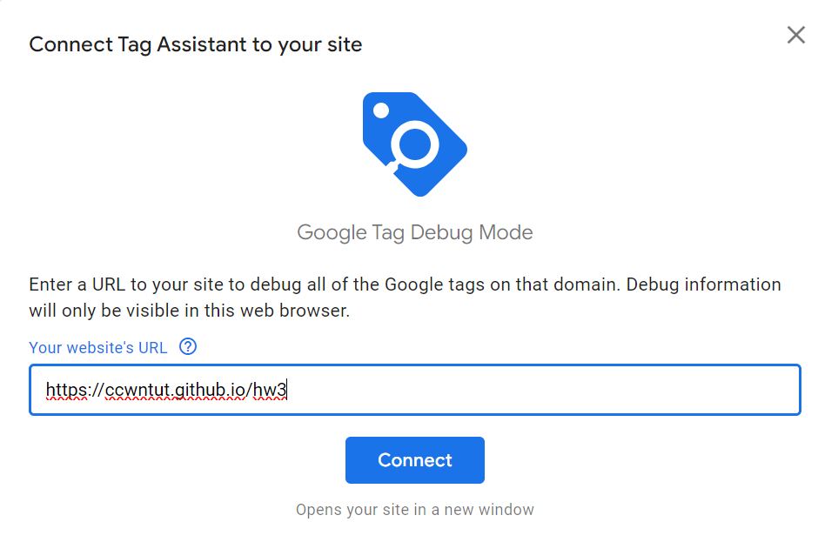
Method 2: Use the Google Tag Assistant website to do a test check
Add Domain
https://ccwntut.github.io/hw3

Slide 69
Domain → Google Tag Assistant 已經連線
Tag Asistant不可以【關閉/或Finish】

Slide 70
Side-by-side 2 web page comparison: scroll/click on the hw4 web page ➜ See the instant reaction of Google Tag Assistant

Slide 71
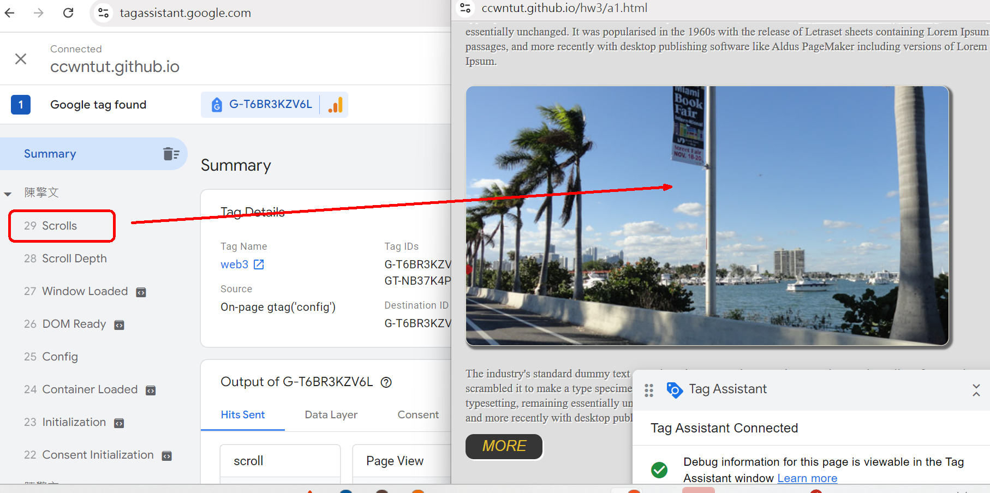
Scroll through the web page a1.html ➜Google Tag Assistant有Scrol事件

Slide 72
9. Conclusion

Slide 73
Conclusion: GA website to apply for an account, the steps to create a resource
(1) Apply for Google Analytic (2) Embed the tracking code on the web page in such a way as you set it up (3) Reports that interpret Google Analytic trackers (related statistics)

